Slide 1
Background for CSCI 4335
Dr. John P. Abraham
Professor
UTRGV

Slide 2
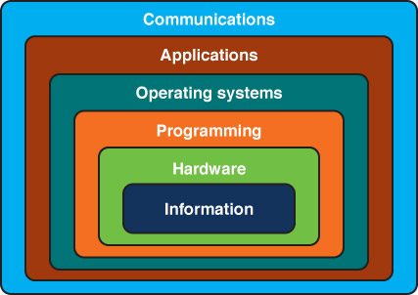
Layers of a Computing System
Dr. John P. Abraham, University of Texas Pan American
4

Slide 3
You may already know this info
These power point slides are only for background purposes. You may want to review them yourself.
Any modifications from you will be welcome.
Thank you.

Slide 4
How does computer work with so many languages & Disciplines
Software
Hardware
  Recognizes switches that are turned off and on
  Transistors can act as switches and amplifiers.
  One switch that provides two states,
Dr. John Abraham, UTRGV

Slide 5
Computer Architecture
What is architecture
  Describes how hardware is organized and enhanced for speed and efficiency and how it interacts with software.
  Sits in the middle of software and hardware
  High level, Low level – assembly & machine languages, Hardware, Movement of electrons
Organization
Dr. John Abraham, UTRGV

Slide 6
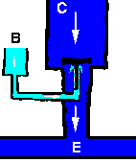
Transistor analogy
C Collector. Power supply voltage
B base
E Emitor
By varying levels of current in B, the amount of current flowing into E can be regulated
Dr. John Abraham, UTRGV

Slide 7
Switches to store data - 2^{n}
1 – 2
2 -4
3 -8
4 -16
5 – 32
6 – 64
7- 128
8 -256
Dr. John Abraham, UTRGV

Slide 8
ASCII and Unicode
8 bits
UTF-16 16 bits
UTF-32 -32 bits
Dr. John Abraham, UTRGV

Slide 9
Opcode and Operand
Operation
And what is operated on
How many instructions needed to handle programmatic need?
Dr. John Abraham, UTRGV

Slide 10
Computer System
CPU - memory
Peripherals (input & output)

Slide 11
CPU
Control unit
ALU
Registers
Interconnection
Dr. John Abraham, UTRGV

Slide 12
Operation of a CPU
1. Figure out where the next instruction is in the memory (instruction address calculation).
2. Fetch the instruction
3. Figure out what the fetched code means (decoding the instruction).
4. If it requires an operand
  a. Figure out where the operand is kept (operand address calculation).
b. Fetch the operand
Dr. John Abraham, UTRGV

Slide 13
continued
c. If there are multiple
operands repeat a and b.
5. Execute the instruction (such as
add, subtract, multiply, jump,
loop, etc)
6. Figure out the location to store
the result (operand address
calculation)
7. store the result, if there are
multiple results repeat 6 and 7.
8. Go back to 1 to do the next
instruction, or End if it is the last
instruction.

Slide 14
Numbers
Natural Numbers
Zero and any number obtained by repeatedly adding one to it.
Examples: 100, 0, 45645, 32
Negative Numbers
A value less than 0, with a – sign
Examples: -24, -1, -45645, -32
2

Slide 15
Numbers
Integers
A natural number, a negative number, zero
Examples: 249, 0, - 45645, - 32
Rational Numbers
An integer or the quotient of two integers
Examples: -249, -1, 0, 3/7, -2/5
3

Slide 16
Natural Numbers
Aha!
642 is 600 + 40 + 2 in BASE 10
The base of a number determines the number of digits and the value of digit positions
5

Slide 17
Positional Notation
Continuing with our example…
642 in base 10 positional notation is:
6 x 10² = 6 x 100 = 600
+ 4 x 10¹ = 4 x 10 = 40
+ 2 x 10º = 2 x 1 = 2 = 642 in base 10
The power indicates
the position of
the number
This number is in
base 10
6

Slide 18
Binary
Decimal is base 10 and has 10 digits: 0,1,2,3,4,5,6,7,8,9
Binary is base 2 and has 2 digits:
0,1
For a number to exist in a given base, it can only contain the digits in that base, which range from 0 up to (but not including) the base.
What bases can these numbers be in? 122, 198, 178, G1A4
9

Slide 19
Bases Higher than 10
How are digits in bases higher than 10 represented?
With distinct symbols for 10 and above.
Base 16 has 16 digits:
0,1,2,3,4,5,6,7,8,9,A,B,C,D,E, and F
10

Slide 20
Converting Octal to Decimal
What is the decimal equivalent of the octal number 642?
6 x 8² = 6 x 64 = 384
+ 4 x 8¹ = 4 x 8 = 32
+ 2 x 8º = 2 x 1 = 2
= 418 in base 10
11

Slide 21
Converting Hexadecimal to Decimal
What is the decimal equivalent of the hexadecimal number DEF?
D x 16² = 13 x 256 = 3328
+ E x 16¹ = 14 x 16 = 224
+ F x 16º = 15 x 1 = 15
= 3567 in base 10
Remember, the digits in base 16 are 0,1,2,3,4,5,6,7,8,9,A,B,C,D,E,F

Slide 22
Converting Binary to Decimal
What is the decimal equivalent of the binary number 1101110?
1 x 2⁶ = 1 x 64 = 64
+ 1 x 2⁵ = 1 x 32 = 32
+ 0 x 2⁴ = 0 x 16 = 0
+ 1 x 2³ = 1 x 8 = 8
+ 1 x 2² = 1 x 4 = 4
+ 1 x 2¹ = 1 x 2 = 2
+ 0 x 2º = 0 x 1 = 0
= 110 in base 10
13

Slide 23
Arithmetic in Binary
Remember that there are only 2 digits in binary, 0 and 1
1 + 1 is 0 with a carry
Carry Values
1 1 1 1 1 1
1 0 1 0 1 1 1
+1 0 0 1 0 1 1
1 0 1 0 0 0 1 0
14

Slide 24
Subtracting Binary Numbers
Remember borrowing? Apply that concept here:
1 2
2 0 2
1 0 1 0 1 1 1
- 1 1 1 0 1 1
0 0 1 1 1 0 0
15

Slide 25
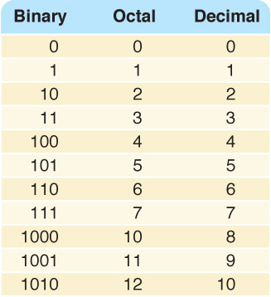
Counting in Binary/Octal/Decimal

Slide 26
Converting Binary to Octal
Mark groups of three (from right)
Convert each group
10101011 10 101 011
2 5 3
10101011 is 253 in base 8
17

Slide 27
Converting Binary to Hexadecimal
Mark groups of four (from right)
Convert each group
10101011 1010 1011
A B
10101011 is AB in base 16
18

Slide 28
Converting Decimal to Other Bases
Algorithm for converting number in base 10 to other bases
While (the quotient is not zero)
  Divide the decimal number by the new base
  Make the remainder the next digit to the left in the answer
  Replace the original decimal number with the quotient
19

Slide 29
Converting Decimal to Octal
What is 1988 (base 10) in base 8?
Try it!

Slide 30
Converting Decimal to Octal
248 31 3 0
8 1988 8 248 8 31 8 3
16 24 24 0
38 08 7 3
32 8
68 0
64
4
Answer is : 3 7 0 4

Slide 31
Converting Decimal to Hexadecimal
What is 3567 (base 10) in base 16?
Try it!
20

Slide 32
Converting Decimal to Hexadecimal
222 13 0
16 3567 16 222 16 13
32 16 0
36 62 13
32 48
47 14
32
15
D E F
21

Slide 33
Binary Numbers and Computers
Computers have storage units called binary digits or bits
Low Voltage = 0
High Voltage = 1 all bits have 0 or 1
22

Slide 34
Binary and Computers
Byte
8 bits
The number of bits in a word determines the word length of the computer, but it is usually a multiple of 8
  32-bit machines
  64-bit machines etc.
23

Slide 35
ELECTRONICS
AN INTRODUCTION
Dr. John P. Abraham

Slide 36
Matter
Atom – Basic building block of elements
Molecules – Same atoms get together
Compounds – Different Atoms combine
Our body is composed of organic and inorganic matter.
  Organic
  Inorganic

Slide 37
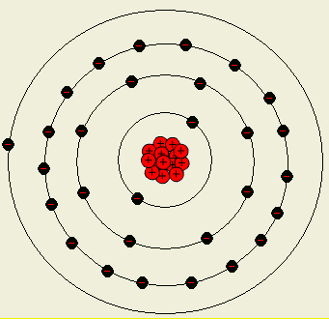
Atom –1

Slide 38
Atom-2
  Each Element has a certain number of electrons and protons. This is what we use to distinguish one element from another. A table called periodic table is derived from this.
  An atom has a nucleon which contains protons (positively charged) and neutrons (no charge).
  An atom also has electrons rotating around the nucleus (BOHR MODEL). A newer model is Quantum Theory.

Slide 39
Atom-3
Electrons are generally in same number as protons thus keeping the charge neutral.
Other terms you will hear are quark (up or down), and electron-neutrino. We will not discuss here.

Slide 40
Atom –4
The electrons rotate around the nucleus in orbits.
Each orbit can have a maximum number of electrons.
Suppose one shell can have 8 electrons. If it only has 7, it will bind with another element to complete that shell. But if it only has 1, it will give up this one to another element by combining with it.

Slide 41
Atom –5
This a copper atom.
Do you see just one electron in the outer shell? More abut it later.

Slide 42
Electric charge
Known 600 years before Christ.
If an amber rod is rubbed against fur the rod becomes electrically charged.
During the rubbing process some electrons are transferred from the fur to the rod.
We can also accumulate charge in our body.
Electrostatic charge can damage electronic components.

Slide 43
Ions
Recall that I said that an atom can either give up or receive electrons.
If an atom gives up electron(s) it becomes a positive ion.
If an atom gains electron(s) it becomes a negative ion.

Slide 44
Insulators
Suppose you only rubbed one end of the rod with fur. The electrons are transferred to that end only.
These electrons can’t travel along the rod because amber, glass, wood etc. are insulators.
Insulators are non-metallic substances such as rubber, glass plastic, ceramic and mica.

Slide 45
Conductors
Electrons in the outer shell can become free by applying some sort of external force such as magnetic field, rubbing, or chemical action.
An electron that became free can move into an atom that just lost an electron. This way an electron can move from one atom to the next (just roaming around).
Substances allowing such movement of electrons are called conductors.
This movement of electrons is the basis of electricity.

Slide 46
Semiconductors
Substances that are both conductors and resistors under certain conditions.
We can make them either to conduct or to resist!! It is wonderful!
This is be principle behind transistors, diodes and other solid state devices.
A material that conducts electricity when exposed to light and resists when exposed to darkness is selenium. This semiconductor is known as a photoconductor.

Slide 47
How a photocopier works
Now that we talked about selenium, I can’t pass it up without talking about photocopiers.
Every copier and laser printers have an aluminum drum coated with positively charged selenium.
When kept in dark it keeps its pos charge.
When an image is shown (light and dark) on the selenium it becomes a conductor and sends its positive charge to the aluminum.
Now a negatively charged toner is wiped on the drum. The toner attaches to the positive areas on the aluminum.
A paper is passed against the drum and the paper gets the toner. Then the paper passes through high heat and the toner is fused on the paper.

Slide 48
More on Resistors
Resistors can be made from carbon particles mixed with a binder material.
Resistance is measured in Ohms or K or M-Ohms.
Rating is calculated using the color bands. BlBROYGBVGrW.
First two band are numerals and third indicate zeros.
VVO – 77000 Ohms
Symbol

Slide 49
Resistor color code
Color of Band | Number (first two bands) | Number of Zeros (Third band)
Black | 0 | 0
Brown | 1 | 1
Red | 2 | 2
Orange | 3 | 3
Yellow | 4 | 4
Green | 5 | 5
Blue | 6 | 6
Violet | 7 | 7
Gray | 8 | 8
White | 9 | 9

Slide 50
Copper Wire as a conductor
Electric current in copper wire is the flow of electrons, but these electrons are not supplied by the power source.
They come from the wire.
Batteries and generators do not create these electrons, they merely pump them, and the electrons are like a pre-existing fluid that is always found within all wires.

Slide 51
Electrons in the copper wire
Recall the copper atom?
One electron from the outer shell just roam around.
If we direct the flow in the same direction then we have current.
Current is measured in Amps. Means how many electrons pass by a fixed point in a second (coulomb per second).
Electrons flow from negative to positive.

Slide 52

Power Source
Makes the electrons move in one direction. It is like a pump.
The force with which electrons move depends on the potential difference.
It is measured in Volts.

Slide 53
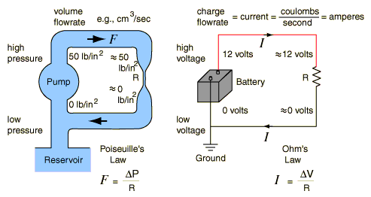
Water analogy

Slide 54
Ohms Law
Current varies directly with voltage.
Current varies inversely with resistance.
I = E/R (Current = voltage/resistance)
E=I x R (Voltage = current * resistance)
R = E/I (Resistance = Voltage/Current)

Slide 55
A Circuit
Voltage source and a load connected by a conductor.
If there is no load we call it a short circuit.

Slide 56
Continuity Test
Checks for line breaks
Finds two ends of a long wire
Finds a part that does not conduct any more.
Your first practical assignment is to make a continuity tester and find ends of wires.

Slide 57
Voltage and Current
Are Voltage and Current Related?
Voltage and current are not the same thing, although they are closely related. In simple terms, Voltage causes Current. Given a Voltage and a path for the electrons, current will flow. Given the path, but no Voltage, or Voltage without the path, there will be no current.

Slide 58
Solve for Amps
Assume that the voltage supplied by the battery is 9 volts and we have load that has a resistance of 5 Ohms.
Find how much current is flowing through the circuit.
I = E/R = 9/5 = 1.8 amps

Slide 59
Solve for Voltage
Assuming a resistance of 10 ohms and 200 mA current what is the voltage in the circuit
E = I * R = 0.2 * 10 = 2 Volts

Slide 60
DC Series Circuit
A series circuit is formed when any number of resistors are connected end-to-end so that there is only one path for current to flow.
Resister here means a device that has resistance. Example a light bulb.

Slide 61
The Rules of a Series Circuit
1) Voltage drops around the circuit are divided in proportion to the ohmic value of each component.
2) Resistances add directly. (i.e. R₁ + R₂)
3) All current flows through all parts. Therefore the amperage on any part of the circuit is the same as the total amperage.

Slide 62
Resistance in serial circuit
Resistance add in a series circuit.
If you have 6 Ohms and 10 Ohms resistors in a series, the total resistance is 16 Ohms.
Rt = r1+r2+r3+r4..+rn

Slide 63
Solve for Resistance
Given a series circuit where
  R1=11 KOhms
  R2=2 KOhms
  R3 = 2 Kohms
  R4 = 100 Ohms
  R5 = 1 Kohms
  What is the total resistance?
  Rt=16,100 Ohms

Slide 64
Solve for Current in Series circuit
Given 12 Volts and 5, 1, 2, 2 Ohms resistors, what is Current in the circuit?
I = E/R = 12/10 = 1.2 amps

Slide 65
Solve for Voltage in a series circuit
There is voltage drop across each resistor in a series circuit.
To calculate 3 steps
  Solve for total resistance. eg Rt= 6 Ohms
  Solve for current. Eg 12 volts/6 Ohms = 2 amps
  Solve for voltage across any resitor
    Eg. E=I * R = 2 * 1.5 (suppose Resister is 1.5 Ohms) = 3 volts.

Slide 66
DC Parallel Circuit
Two or more devices are placed in a circuit side by side so that current can flow through more than one path.

Slide 67
The Rules of a Parallel Circuit
1) Voltage across parallel components is equal.
2) Current splits between parallel elements depending on the ratio of the currency.
3) Total resistance is always smaller than the smallest resistor.

Slide 68
Solve for Resistance
Suppose there are 3 resistors, 5, 10 and 20 ohms in a parallel circuit. What is the total resistance?
1/Rt = 1/R1 + 1/R2 + 1/R3
1/Rt=1/5 + 1/10 + 1/20
1/Rt= 7/20
R1 = 20/7 = 2.86 ohms

Slide 69
Solve for Voltage in Parallel Circuit
It is the same across all resistors. If the voltage source is 12 v, voltage across all resisters in that parallel circuit is 12 v.

Slide 70
Solve for current in parallel circuit
Suppose 12 volts power source and 40 and 20 ohms devices in parallel, calculate current.
Current is divided among each branch of the circuit.
It = I1+I2+I3..
I1 = E/R1 = 12/40 =0.3 amps
I2 = E/R2 = 12/20 = 0.6 amps
It = I1 + I2 = 0.3+0.6 = 0.9 amps.

Slide 71
Power
Power is the measure of how quickly work is done. Measure Power by dividing work (joules) performed by time. (P=W/t).
One joule per second is a Watt.
Power also is measured as horsepower which is 756 Watt.

Slide 72
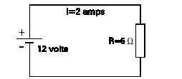
Watt
The rate work is done in a circuit when 1 amp flows with 1 volt applied. (For example take 12 V, 2A, and 6 Ohms circuit).
Power consumed (Watts) = E * I =12 * 2 =24 watts.
= I*I * R = 2*2*6 = 24 Watts
= E*E /R = 12*12/6 = 24 Watts.

Slide 73
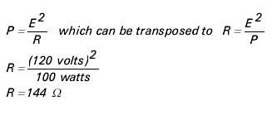
Power Rating of Equipment
Electrical equipment is rated in Watts
Example light bulb 120 V and 100 Watts.
How to calculate Resistance of this bulb

Slide 74
Magnetism
Every magnet has North pole and South pole.
Invisible magnetic lines of flux leave the north pole and enter the south pole.
Like poles repel each other.
Electromagnetic field is generated by current flow in a conductor.
If you hold the wire with your left hand with your thumb point the same direction as the electron flow, then your fingers point to the direction of magnetic flux.

Slide 75
DC vs. AC
DC – Direct Current
  Battery and DC generators
  Electrons flow in one direction
AC – Alternating Current
  AC generator
  Reverses terminal polarity several times a second.
  110 V 60 Hz.

Slide 76
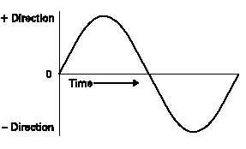
Sine wave

Slide 77
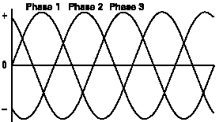
Single and 3 Phase AC
Single phase for home
3 phase for commercial applications.

Slide 78
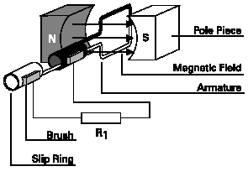
Generators

Slide 79
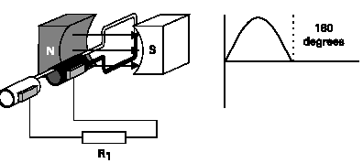
Generation of AC

Slide 80
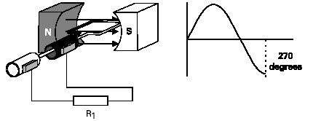
Generation of AC

Slide 81
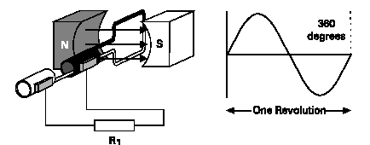
Generation of AC

Slide 82
Frequency
How often does it reverse polarity?
60 cycles per second or 60 Hz

Slide 83
Inductance
A changing current in one coil induces a current in another coil.
Current flow produces a magnetic field in a conductor.
The amount of current determines the strength of the magnetic field.
Since AC is constantly changing current inductance always is happening.

Slide 84
Transformer
Change voltage from one voltage from value to another.
High voltage power lines carry 750,000 V, and must be stepped down to 120V.
For computer applications we need to step down from 120 to 12 or 5 volts.
For a TV tube we need to step up to 15,000 Volts.

Slide 85
Transformer

Slide 86
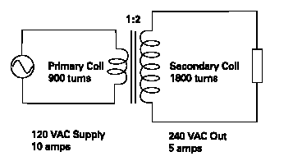
Step Up Transformer

Slide 87
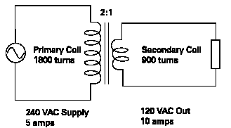
Step down Transformer

Slide 88
Capacitor
Stores Electrical charge
Pair of conductive plates separated by a thin layer of insulating (dielectric) material.
When current is applied the electrons are forced on one plate.

Slide 89
Capacitor
The electrons are accumulated on one plate until it reaches a saturation.
Uses:
  Pass AC while blocking DC
  Store electricity
  A filter to smooth out pulsating signals
Capacitance is measured in micro Farads.

Slide 90
Diode
is an electronic switch
Positive terminal p-type semiconductor (anode)
Neg n-type semiconductor material(cathod)
When v=0.6 is applied the switch closes
Anode Cathode

Slide 91
Diodes
Diodes can be used as voltage regulators, tuning devices in rf tuned circuits, frequency multiplying devices in rf circuits, mixing devices in rf circuits, switching applications or can be used to make logic decisions in digital circuits.

Slide 92
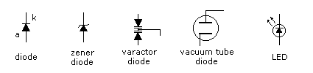
LED
There are also diodes which emit "light", of course these are known as light-emitting-diodes or LED's. As we say diodes are extremely versatile. Current can only flow from anode to cathode and not in the reverse direction, hence the "arrow" appearance.
Notes:
The second of the diodes is a zener diode which are fairly popular for the voltage regulation of low current in power supplies.

Slide 93
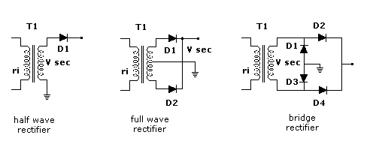
Rectifying diodes
The principal early application of diodes was in rectifying 50 / 60 Hz AC mains to raw DC which was later smoothed by capacitors.

Slide 94
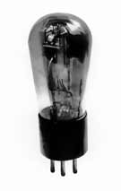
Introduction to transistors
The Transistor was probably the most important invention of the 20th Century.
In 1939, vacuum tubes were state of the art in radio equipment. People had previously used crystals for radios, but the crystals were so maddeningly inconsistent and mysterious it was a wonder they worked at all. Vacuum tubes were simple, and they worked. Most scientists agreed tubes were the future for radio and telephones everywhere.

Slide 95
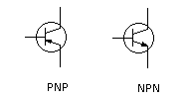
The Invention of the First Transistor
November 17-December 23, 1947
The key components were a slab of germanium and two gold point contacts just fractions of a millimeter apart.

Slide 96
Transistor
Semiconductors with too many electrons are known as N-type and semiconductors with too few electrons are known as P-type.
The boundary between these two kinds of semiconductors is known as a P-N junction, and it's a crucial part of a transistor.
A small current in through one contact changes the nature of the semiconductor so that a larger, separate current starts flowing across the germanium and out the second contact.

Slide 97
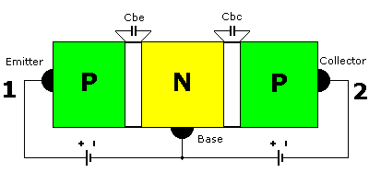
PNP Transistor
Transistor provides insulation, conductivity and amplification

Slide 98
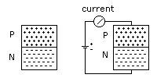
Conductivity
If we take a piece of the p-type material and connect it to a piece of n-type material and apply voltage as in the figure then current will flow. Electrons will be attracted across the junction of the p and n materials. Current flows by means of electrons going one way and holes going in the other direction. If the battery polarity were reversed then current flow would cease.

Slide 99
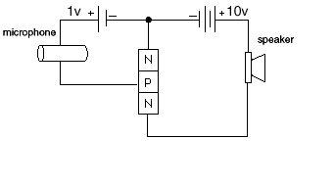
Amplification
With an NPN transistor, if the base is open, then a small amount of current flowing into the base will lead to a much larger current flow in the collector. The ratio is the gain of the particular transistor. Hence a transistor is known as a current amplifier.

Slide 100
Transistor Categories
Generally transistors fall into the category of bipolar transistor, either the more common NPN bipolar transistors or the less common PNP transistor types. There is a further type known as a FET transistor which is an inherently high input impedance transistor with behaviour somewhat comparable to valves. Modern field effect transistors or FET's including JFETS and MOSFETS now have some very rugged transistor devices.
Semiconductor material which conducts by free electrons is called n-type material while material which conducts by virtue of electron deficiency is called p-type material.

Slide 101
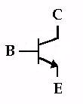
Basic Transistor circuit
The Base (B) is the On/Off switch for the transistor. If a current is flowing to the Base, there will be a path from the Collector (C) to the Emitter (E) where current can flow (The Switch is On.) If there is no current flowing to the Base, then no current can flow from the Collector to the Emitter. (The Switch is Off.)

Slide 102
Digital systems
classified as
  combinational
    contain no memory
    example will be a binary adder (input, output only)
  sequential
    requires memory to remember the present state to go to the next state
    counter is an example
Computers are clocked sequential systems

Slide 103
Transistor Transistor Logic-TTL
TTLs evolved from diodes and transistors
  Power supplied required is +5V
  TTLs outputs
    open-collector, totem-pole, and tristate

Slide 104
MOS Transistors
Metal-Oxide Semiconductor
  occupies less space and consume less power
  used in highly integrated circuuits
  MOS transistor operates as a voltage controlled resistance switch.
  If resistance is very high switch is off.
  If the resistance is very low it is on.
  Two types - nMOS and pMOS

Slide 105
Complementary MOS (CMOS)
CMOS is fabricated by combining nMOS and pMOS together.
  CMOS dissipates low power and offers short propagation delays.
  CMOS provides high circuit density
  high noise immunity

Slide 106
Integrated Circuits (Ics)
Device level design utilizes transistors to design circuits called gates.
  One or more gates on a single silicon chip is an integrated circuit
  small-scale integration (SSI)
  medium scale integration (MSI)
  Large-scale integration (LSI)
  Very large scale integration (VLSI)

Slide 107
Basic logic operations
  Not operation. Symbol is +
    not gate is an INVERTER
    a transistor acts an inverter
  OR operation
Or operation
Or gate may be implemented using 2 diodes or transistors

Slide 108
AND
  Variables A and B must be true to get a true output. Symbols are . And ^
And gate can be constructed with 2 diodes or transistors

Slide 109
Other operations
NOR operation
  invert the result of an or operation
NAND
  invert the output of an AND operation
XOR
  produces a one if inputs are different, zero if inputs are the same.
XNOR
  produces a one if inputs are the same.

Slide 110
Combinational logic design
  A combinational circuit is designed using logic gates in which application of inputs generates the outputs at any time
  examples are: adders, subtractors, decoders, encoders, multiplexers and demultiplexers.
  The results are based on the truth table

Slide 111
Sequential Logic Design
  Designed using logic gates and memory elements known as flip-flops.
    A flip flop is a one bit memory. (a latch).
    Output will depend upon present inputs and previous states stored in memory.
    To distinguish different states a clock is used.
    There are synchronous and asynchronous sequential circuits. Synchronous are regulated by a clock. In asynchronous, completion of one task automatically starts another, no clock is needed.

Slide 112
RAM
RAM is of two types
  static ram - stores each bit in a flip-flop
  dynamic ram - stores each bit as a charge in a capacitor.
    Capacitors can store charges only for few ms.
    So refreshing is needed.

Slide 113
Gates
Six types of gates
  NOT
  AND
  OR
  XOR
  NAND
  NOR
Typically, logic diagrams are black and white with gates distinguished only by their shape
We use color for emphasis (and fun)

Slide 114
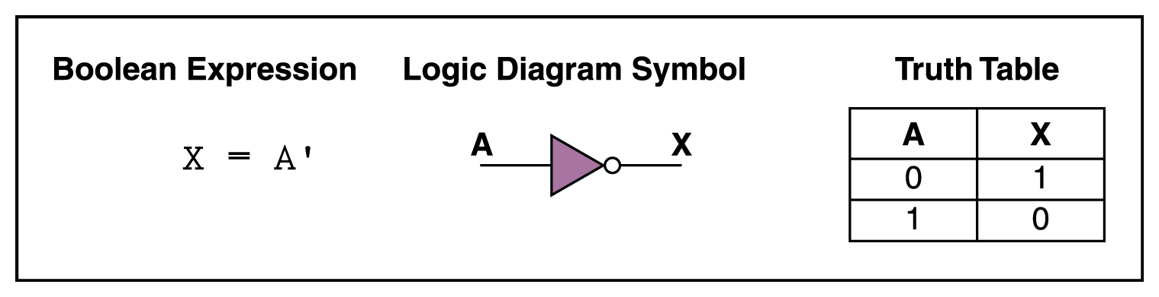
NOT Gate
A NOT gate accepts one input signal (0 or 1) and returns the opposite signal as output
Figure 4.1 Various representations of a NOT gate

Slide 115
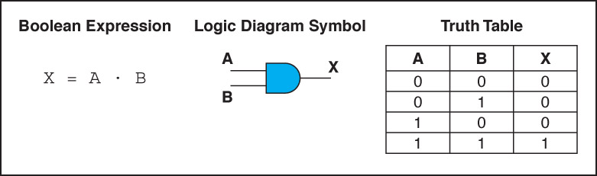
AND Gate
An AND gate accepts two input signals
If both are 1, the output is 1; otherwise,
the output is 0
Figure 4.2 Various representations of an AND gate

Slide 116
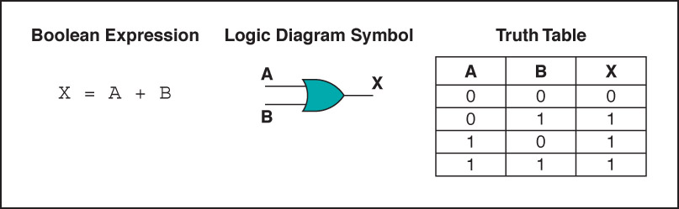
OR Gate
An OR gate accepts two input signals
If both are 0, the output is 0; otherwise,
the output is 1
Figure 4.3 Various representations of a OR gate

Slide 117
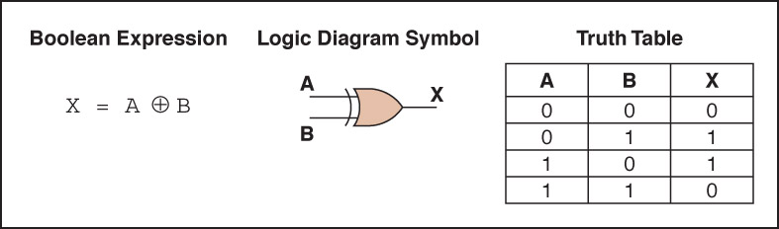
XOR Gate
An XOR gate accepts two input signals
If both are the same, the output is 0; otherwise,
the output is 1
Figure 4.4 Various representations of an XOR gate

Slide 118
XOR Gate
Note the difference between the XOR gate
and the OR gate; they differ only in one
input situation
When both input signals are 1, the OR gate produces a 1 and the XOR produces a 0
XOR is called the exclusive OR

Slide 119
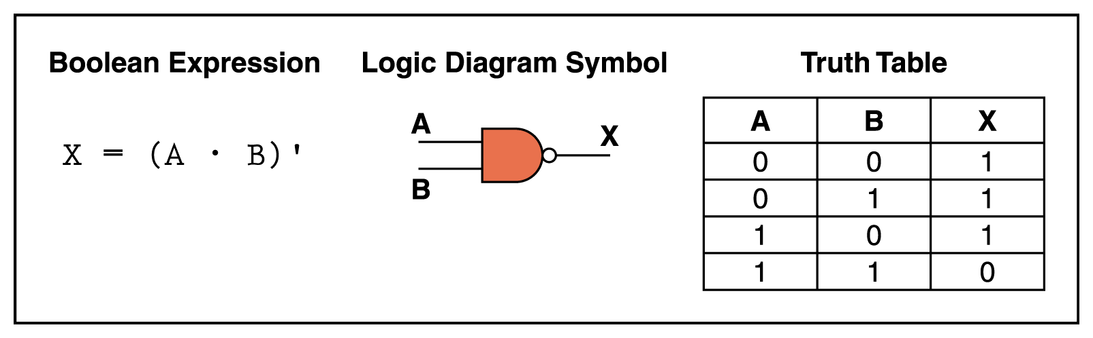
NAND Gate
The NAND gate accepts two input signals
If both are 1, the output is 0; otherwise,
the output is 1
Figure 4.5 Various representations of a NAND gate

Slide 120
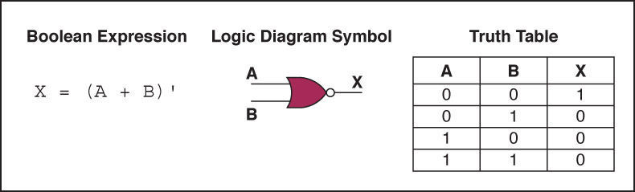
NOR Gate
The NOR gate accepts two input signals
If both are 0, the output is 1; otherwise,
the output is 0
Figure 4.6 Various representations of a NOR gate

Slide 121
Review of Gate Processing
A NOT gate inverts its single input
An AND gate produces 1 if both input values are 1
An OR gate produces 0 if both input values are 0
An XOR gate produces 0 if input values are the same
A NAND gate produces 0 if both inputs are 1
A NOR gate produces a 1 if both inputs are 0

Slide 122
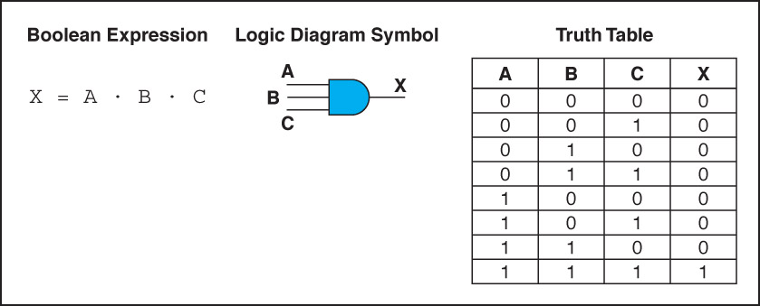
Gates with More Inputs
Gates can be designed to accept three or more input values
A three-input AND gate, for example, produces an output of 1 only if all input values are 1
Figure 4.7 Various representations of a three-input AND gate

Slide 123
Constructing Gates
Transistor
A device that acts either as a wire that conducts electricity or as a resistor that blocks the flow of electricity, depending on the voltage level of an input signal
A transistor has no moving parts, yet acts like
a switch
It is made of a semiconductor material, which is neither a particularly good conductor of electricity nor a particularly good insulator

Slide 124
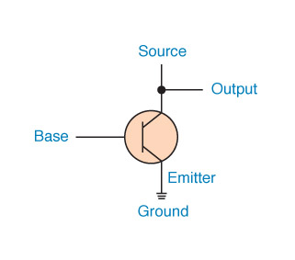
Constructing Gates
A transistor has three terminals
  A source
  A base
  An emitter, typically connected to a ground wire
If the electrical signal is grounded, it is allowed to flow through an alternative route to the ground (literally) where it can do no harm
Figure 4.8 The connections of a transistor

Slide 125
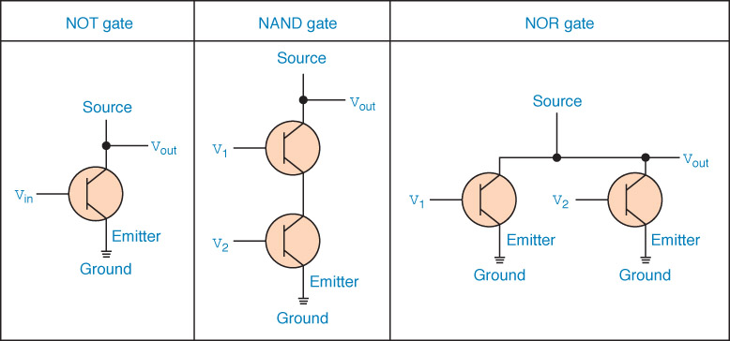
Constructing Gates
The easiest gates to create are the NOT, NAND, and NOR gates
Figure 4.9 Constructing gates using transistors

Slide 126
Circuits
Combinational circuit
The input values explicitly determine the output
Sequential circuit
The output is a function of the input values and the existing state of the circuit
We describe the circuit operations using
  Boolean expressions
  Logic diagrams
  Truth tables
Are you surprised?

Slide 127
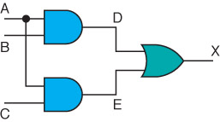
Combinational Circuits
Gates are combined into circuits by using the output of one gate as the input for another

Slide 128
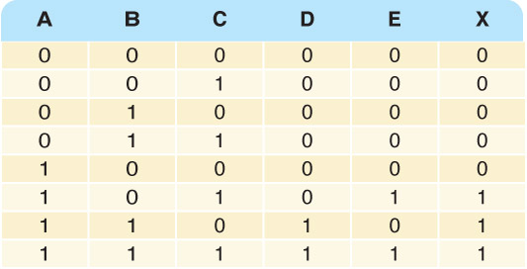
Combinational Circuits
Three inputs require eight rows to describe all possible input combinations
This same circuit using a Boolean expression is (AB + AC)

Slide 129

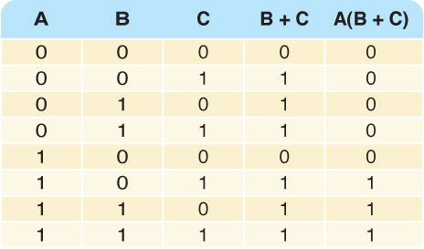
Combinational Circuits
Consider the following Boolean expression A(B + C)
Does this truth table look familiar?
Compare it with previous table

Slide 130
Combinational Circuits
Circuit equivalence
Two circuits that produce the same output for identical input
Boolean algebra allows us to apply provable mathematical principles to help design circuits
A(B + C) = AB + BC (distributive law) so circuits must be equivalent

Slide 131
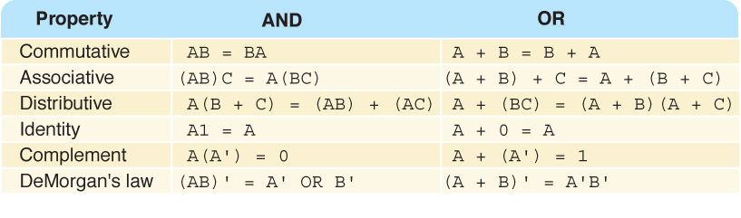
Properties of Boolean Algebra

Slide 132
Adders
At the digital logic level, addition is performed in binary
Addition operations are carried out
by special circuits called, appropriately, adders

Slide 133
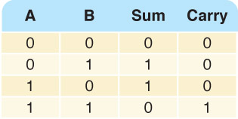
Adders
The result of adding two binary digits could produce a carry value
Recall that 1 + 1 = 10
in base two
Half adder
A circuit that computes the sum of two bits
and produces the correct carry bit
Truth table

Slide 134
Half Adder
  #include <iostream.h>
  void main()
  {
  short x,y, sum, carry;
  bool a,b,c,d;
  cout <<"Enter two bits to add seperated by a space ";cin >> x>>y;
  a=x==1; b=y==1; //actually c++ assigns 0 for false and 1 for true, we could have read these directly;
  c=(a||b) && !(a&&b);
  d=(a&&b);
  9
  sum=c?1:0; //if c is true then sum gets 1 else sum gets 0
  carry=d?1:0;
  cout <<x <<"+"<<y <<"="<<carry<<sum<<endl;
  if (a = true) cout <<"it is true";
  if (a) cout << "it is ture";
  }

Slide 135
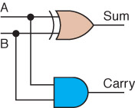
Adders
Circuit diagram representing
a half adder
Boolean expressions
sum = A ⊕ B
carry = AB

Slide 136
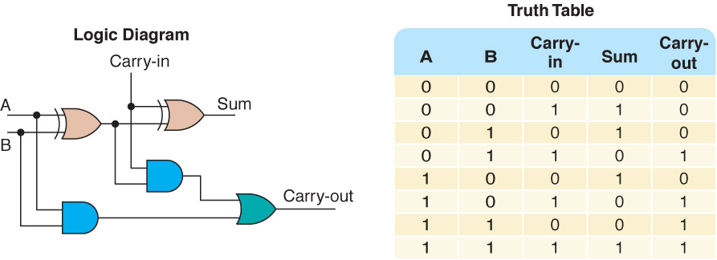
Adders
Full adder
A circuit that takes the carry-in value into account
Figure 4.10 A full adder

Slide 137
Multiplexers
Multiplexer
A circuit that uses a few input control signals to determine which of several output data lines is routed to its output

Slide 138
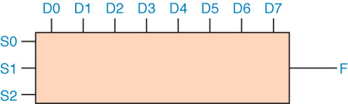
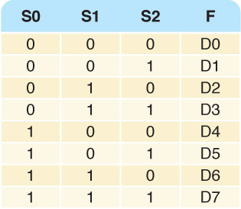
Multiplexers
The control lines S0, S1, and S2
determine which of eight other input lines
(D0 … D7)
are routed to the output (F)
Figure 4.11 A block diagram of a multiplexer with three select control lines

Slide 139
Circuits as Memory
Digital circuits can be used to store information
These circuits form a sequential circuit, because the output of the circuit is also used as input to the circuit

Slide 140
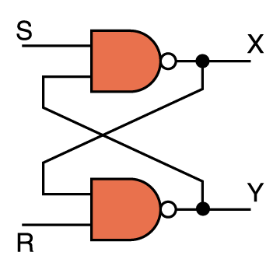
Circuits as Memory
An S-R latch stores a single binary digit
(1 or 0)
There are several ways an S-R latch circuit can be designed using various kinds of gates
Figure 4.12 An S-R latch

Slide 141
Circuits as Memory
The design of this circuit guarantees that the two outputs X and Y are always complements of each other
The value of X at any point in time is considered to be the current state of the circuit
Therefore, if X is 1, the circuit is storing a 1; if X is 0, the circuit is storing a 0
Figure 4.12 An S-R latch

Slide 142
Integrated Circuits
Integrated circuit (also called a chip)
A piece of silicon on which multiple gates have been embedded
Silicon pieces are mounted on a plastic or ceramic package with pins along the edges that can be soldered onto circuit boards or inserted into appropriate sockets

Slide 143
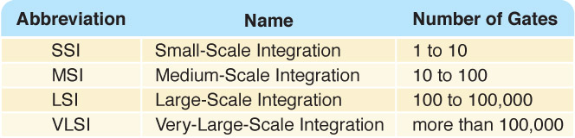
Integrated Circuits
Integrated circuits (IC) are classified by the number of gates contained in them

Slide 144
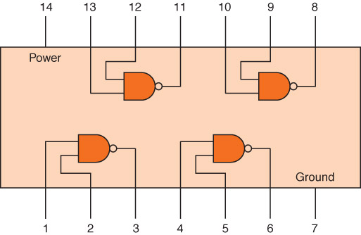
Integrated Circuits
Figure 4.13 An SSI chip contains independent NAND gates

Slide 145
CPU Chips
The most important integrated circuit
in any computer is the Central Processing Unit, or CPU
Each CPU chip has a large number of pins through which essentially all communication in a computer system occurs

Slide 146
Computer Programming Languages
Computers perform operations such as moving data and data manipulation by activating switches and gates.
Instructions to do that also must be given in the form of 1s and 0s or on and off.
When we program computers using just ones and zeros we are using the “machine language”.
When a program is written using human readable code line for line of machine code, that language is called Assembly language. Human readable code is called Mnemonics.
When a programmer can use mathematical symbols and familiar English words such as write (a+b) that language is called a High Level language. Each of the program line will be converted to several lines of assembly or machine code.
More about it later
UTRGV
Dr. John P. Abraham

